Slide 1
SQL PROJECT -
CAR LAUNCH ANALYSIS IN UK MARKET

Slide 2

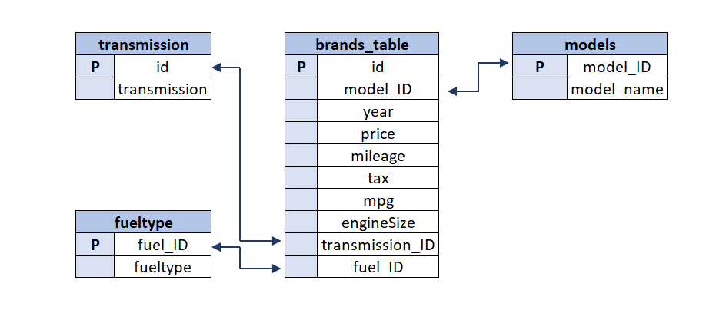
DATA OVERVIEW

Slide 3
PROJECT OVERVIEW-1
You are working as an analyst for a Car brand. The brand wants to launch one(or multiple types) car. You are given
the post-purchase data for various Car brands and their models and have been asked to create a detailed analysis using the given data:
(You can be creative to find other important parameters as well)
a. Create an analysis to find income class of UK citizens based on price of Cars(You can use per-capita income in UK from internet sources)
b. Categorize the cars on the basis of their price(Create as many buckets as you want as per your understanding of data) and analyze the:
a. price changes across the years and identify the categories which has seen significant jump in its price
b. changes in no of cars sold across the years and identify the categories which has seen significant jump in its sales
Using the above identified categories for both points (a) & (b), do a root cause analysis to identify the probable reason for their increase.
For, e.g., Its fuel efficiency as compared to other types of car could be a reason.
c. Find relationship between fuel efficiency & price of car/sales of car/fuel type/, etc.

Slide 4
PROJECT OVERVIEW-2
d. Create an analysis to show the effect of fuel expenditure on the sales of car over the years(Get the fuel prices in UK through the years through internet sources)
Using all of the above analysis, suggest cost and usage effective car type for the brand to launch(We can launch multiple types of car as well)
You are also asked to rank across all the models based on their total sales, average price, average mileage, average engine size, etc.
and now filter the top 5 basis their sales. Observe the identified models and provide your inference.
Provide your findings in an excel workbook, plot graphs & create multiple tabs as needed, be as creative as you can, make dynamic dashboards with global filters.

